Slide 1

Contrast Preserving Decolorization
Cewu Lu, Li Xu, Jiaya Jia,
The Chinese University of Hong Kong

Slide 2
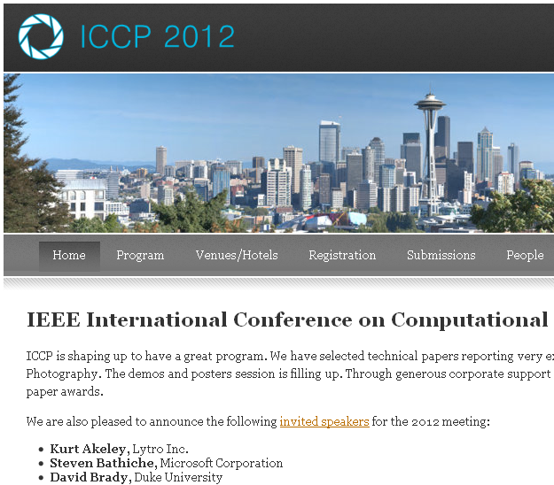
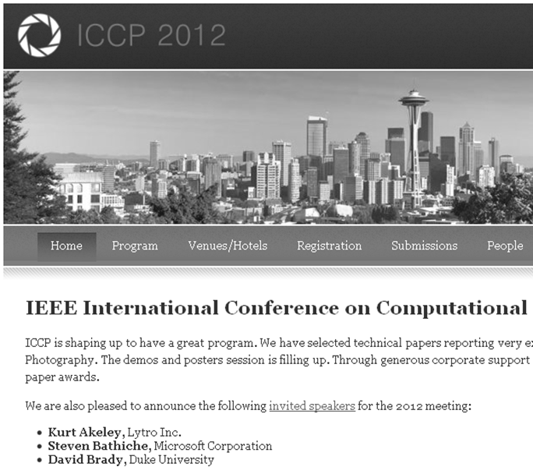

Mono printers are still the majority
Fast
Economic
Environmental friendly

Slide 3
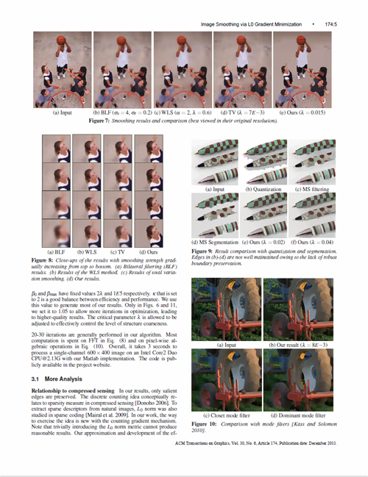
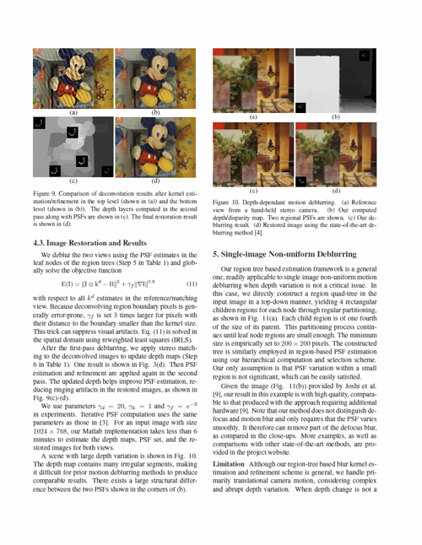
Documents generally have color figures

Slide 4
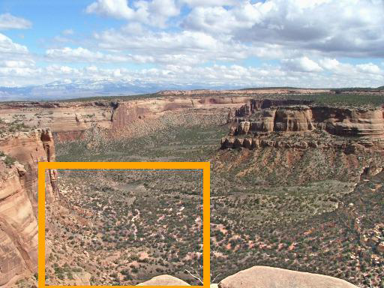
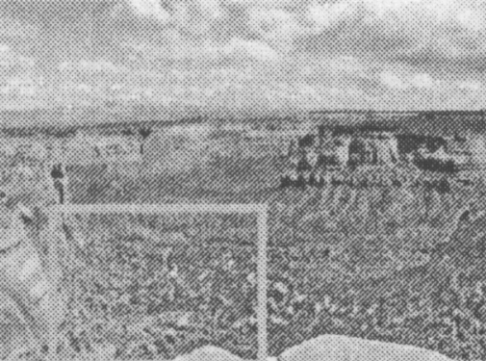
The printing problem

Slide 5
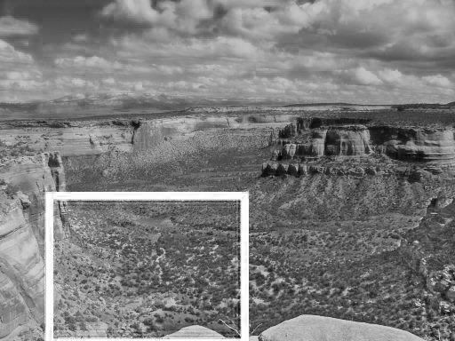
The printing problem

Slide 6
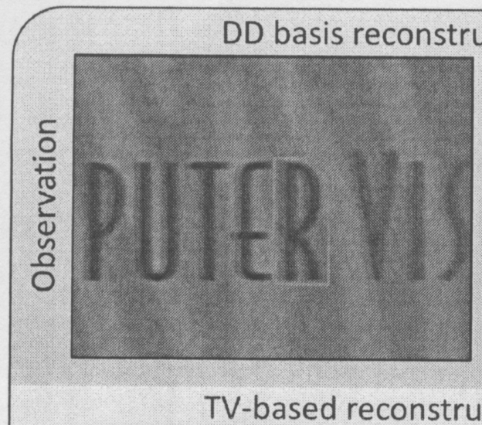
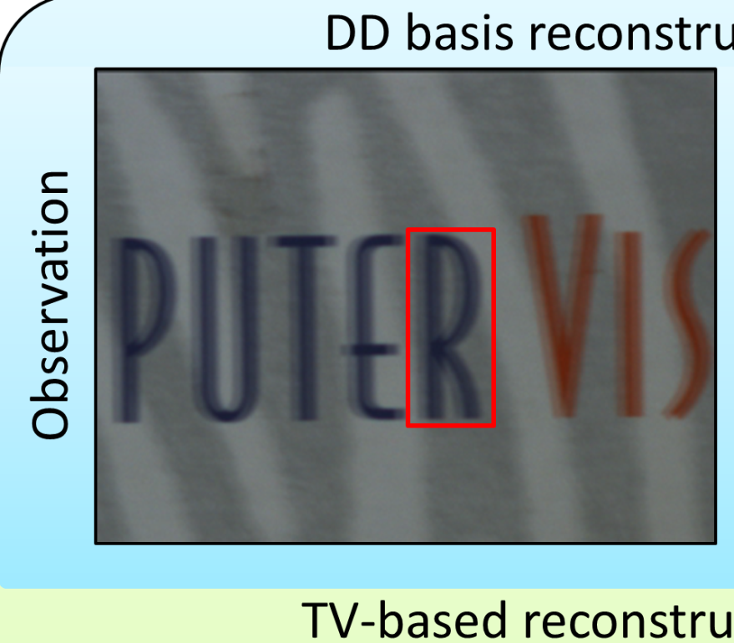
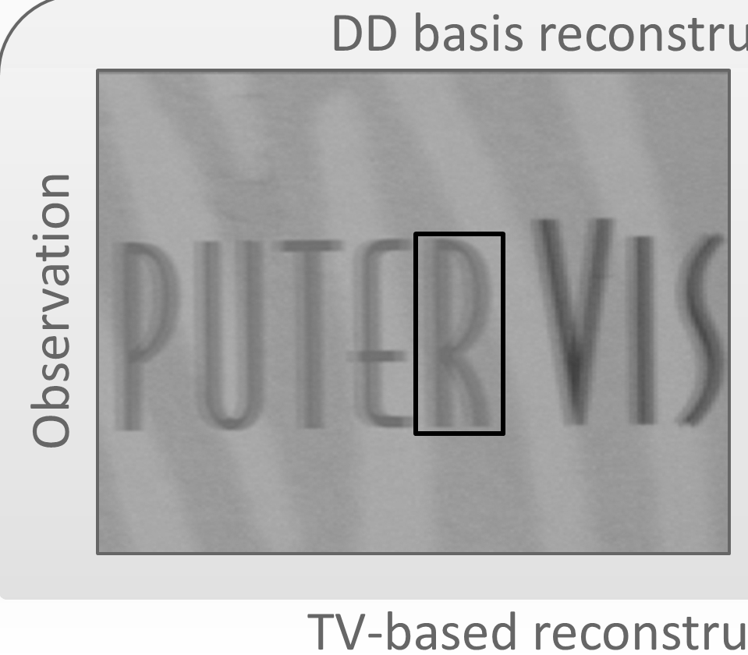
The printing problem

Slide 7
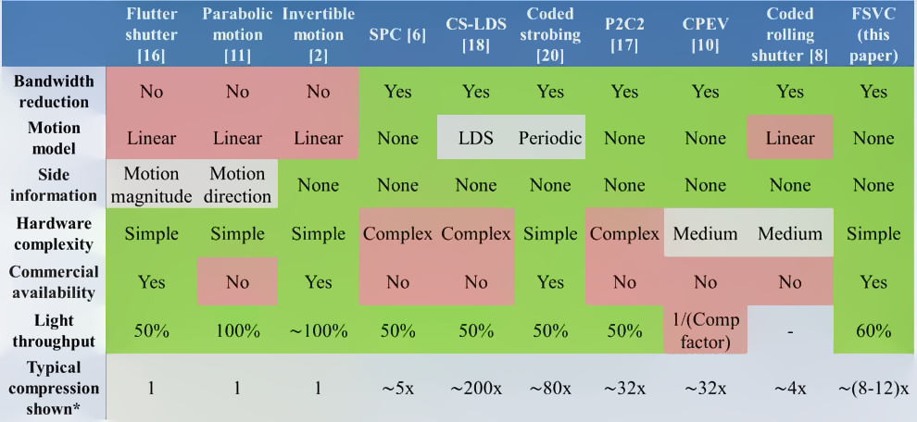
The printing problem
Notes:
Print using HP printer

Slide 8
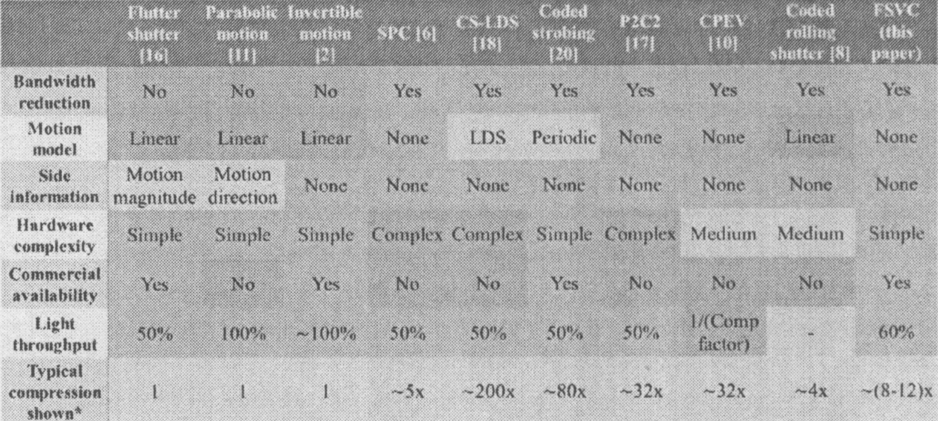
The printing problem
HP printer
Notes:
Print using HP printer

Slide 9
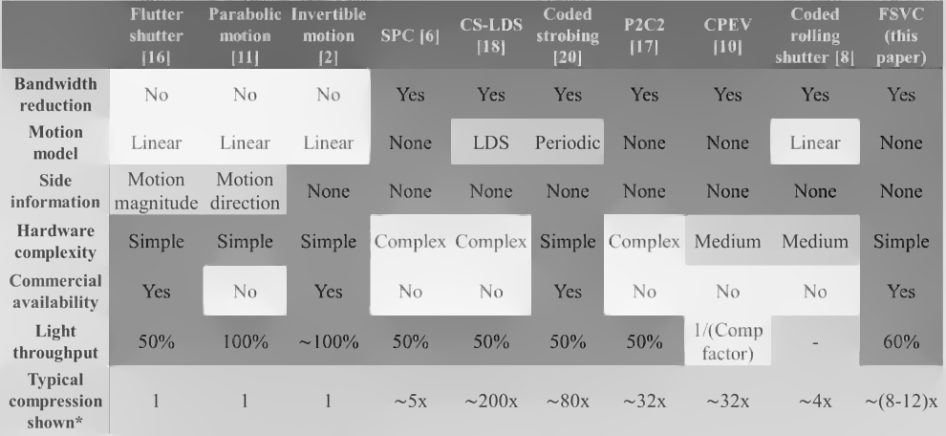
The printing problem
Our Result
Notes:
Print using HP printer

Slide 10

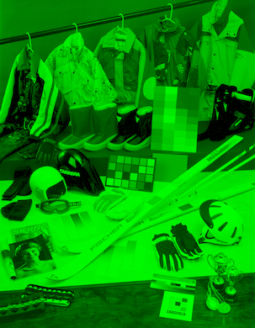
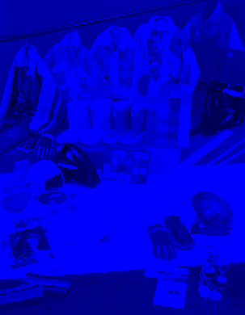
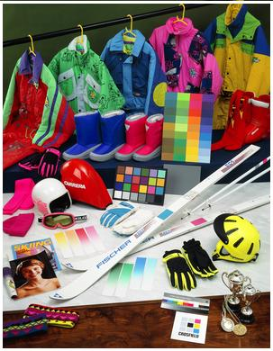
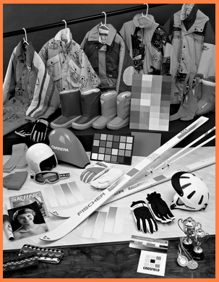
Decolorization
Mapping
Single Channel

Slide 11
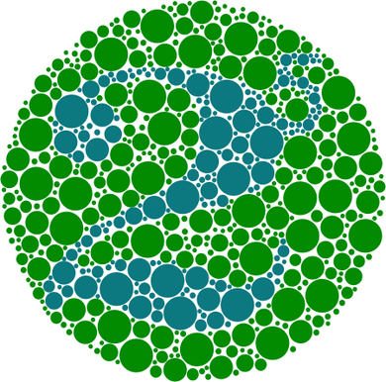


Applications
Color Blindness
Notes:
Color blindness help

Slide 12
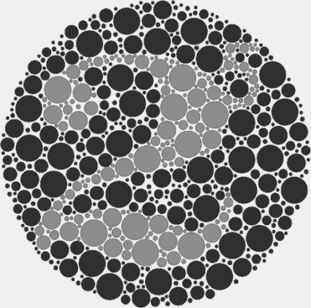

Applications
Color Blindness
Notes:
Color blindness help

Slide 13




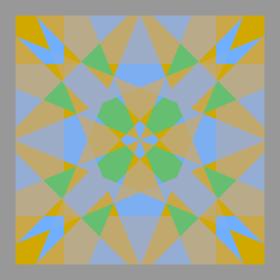
Decolorization could lose contrast
Mapping( )
=
Mapping( )
=

Slide 14

Decolorization could lose contrast
Mapping

Slide 15
Pervious Work (Local methods)
Bala and Eschbach 2004
Neumann et al. 2007
Smith et al. 2008

Slide 16

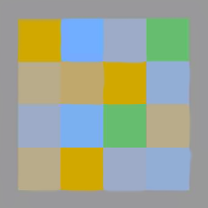
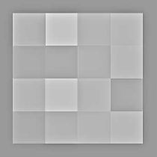
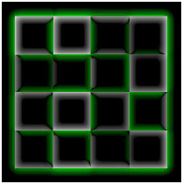
Pervious Work (Local methods)
Naive Mapping
Result
Color Contrast
Notes:
Local methods: Given a color image, a gray image is generated using naive color-to-gray methods such as YUV , Lab system. At the same time, color contrast is extracted.
We use color contrast map to enhance obtained gray image. It can avoid color contrast loss.
Pixels with same color may output different gray value.
It relies on the local chrominance edges for enhancement.
Appearance of constant color regions may distort.
Haloing artifacts may produce.

Slide 17
Pervious Work (Global methods)
Gooch et al. 2004
Rasche et al. 2005
Kim et al. 2009

Slide 18

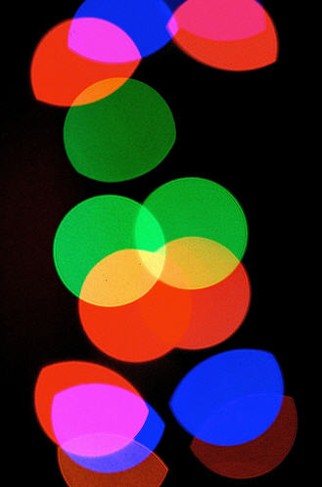
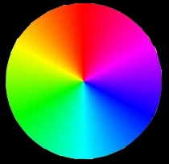
Pervious Work (Global methods)
Color feature
preserving optimization
mapping function

Slide 19
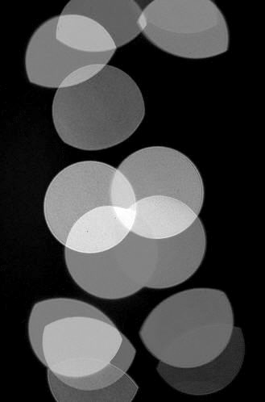
Pervious Work (Global methods)
In most global methods, color order is strictly satisfied

Slide 20


Color order could be ambiguous
Can you tell the order?

Slide 21
Color order could be ambiguous
brightness( ) < brightness ( ) YUV space
Lightness( ) > Lightness ( ) LAB space

Slide 22
Color order could be ambiguous
The order of different colors cannot be defined uniquely by people
B. Wong et al., Nature Methods, 2010
People with different culture and language background have different senses of brightness with respect to color.
E. Ozgen et al., Current Directions in Psychological Science, 2004
K. Zhou et al., National Academy of Sciences, 2010

Slide 23
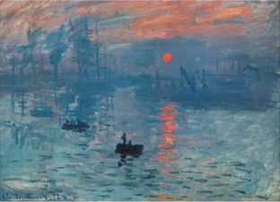
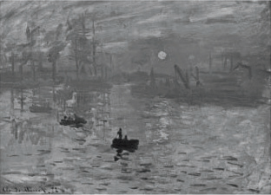
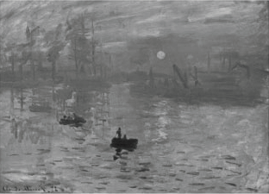
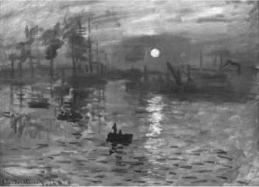
Color order could be ambiguous
If we enforce the color order constraint, contrast loss could happen
Input
[Rasche et al. 2005]
[Kim et al. 2009]
Ours

Slide 24
Our Contribution
Relax the color
order constraint
Bimodal Contrast-Preserving
Unambiguous color pairs
Weak Color Order
Global Mapping
Polynomial Mapping
Notes:
Our main contribution is threefold.

Slide 25
The Framework
Objective Function
Bimodal Contrast-Preserving
Weak Color Order
Finite Multivariate Polynomial Mapping Function
Numerical Solution

Slide 26
Bimodal Contrast-Preserving
Color pixel , grayscale contrast ,
color contrast (CIELab distance)
follows a Gaussian distribution with mean

Slide 27
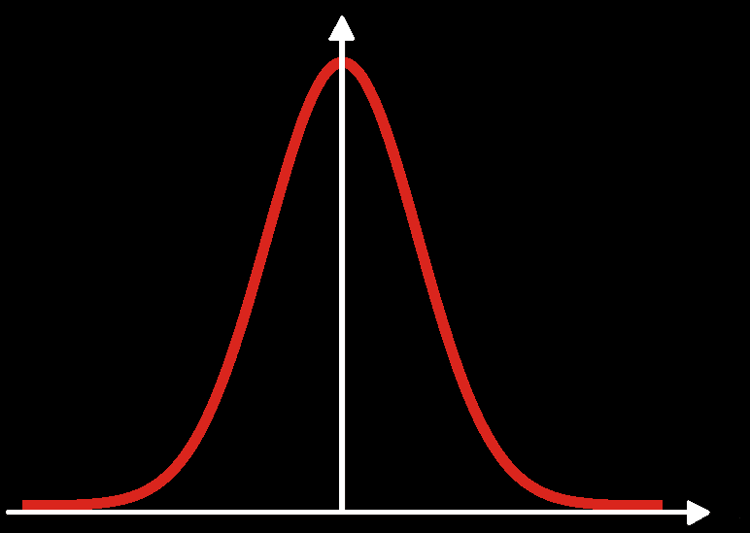
Bimodal Contrast-Preserving
Color pixel , grayscale contrast ,
color contrast (CIELab distance)
follows a Gaussian distribution with mean .

Slide 28
Bimodal Contrast-Preserving
Tradition methods (order preserving):
: neighborhood pixel set
Our bimodal contrast-preserving for ambiguous color pairs:
Notes:
Traditional methods are strictly preserving, meaning that the constrast in color and in grayscale is signed and they should be the same.
As discussed, it is not optimal. We thus propose a bimodel constrast preserving. As for the blue and red, the contrast can be in any order. So We say it is bimodal.

Slide 29
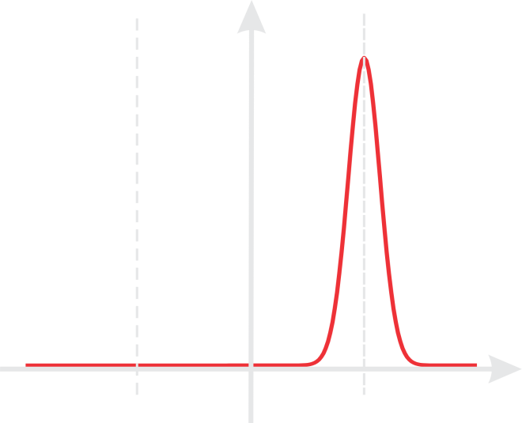
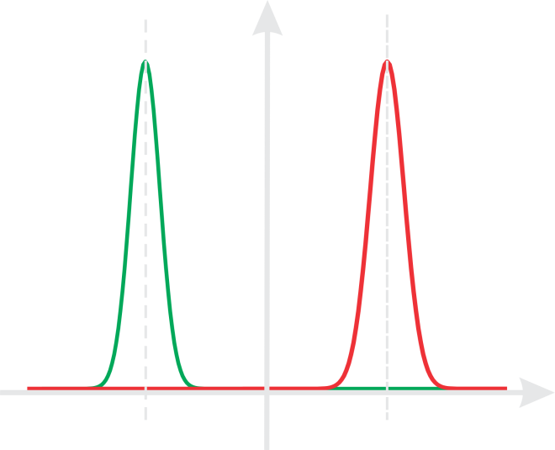
Bimodal Contrast-Preserving
Notes:
Sign compares x and y under given color order system, if x > y, it outputs +1, otherwise -1.

Slide 30
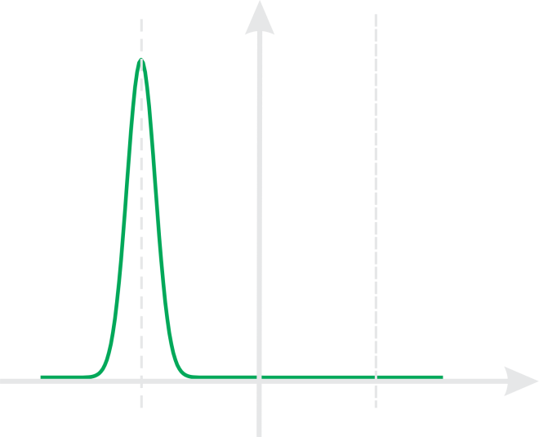
Bimodal Contrast-Preserving
Notes:
Sign compares x and y under given color order system, if x > y, it outputs +1, otherwise -1.

Slide 31
Our Work
Objective Function
Bimodal Contrast-Preserving
Weak Color Order
Finite Multivariate Polynomial Mapping Function
Numerical Solution
Notes:
This is only for ambiguous color pairs.

Slide 32









Weak Color Order
Unambiguous color pairs:
or
Notes:
We also define unambiguous color pair. For example, if there are two colors, in all three channels, one is brighter than the other. There is no ambiguity to define the order.

Slide 33
Weak Color Order
Unambiguous color pairs:
or
Our model thus becomes

Slide 34
Our Work
Objective Function
Bimodal Contrast-Preserving
Weak Color Order
Finite Multivariate Polynomial Mapping Function
Numerical Solution

Slide 35
Multivariate Polynomial Mapping Function
Solve for grayscale image:
Variables (pixels): 400x250 = 100,000
Too many (easily produce unnatural structures)
Example
Notes:
The variable to optimize is huge.

Slide 36
Multivariate Polynomial Mapping Function
Parametric global color-to-grayscale mapping
Small Scale
Notes:
c is color pixel RGB, g is gray output.
W is parametric to optimize.
This can significantly reduce the variables while not causing visual artifacts.

Slide 37
Multivariate Polynomial Mapping Function
Parametric color-to-grayscale
is the monomial basis of , .
When n = 2, a grayscale is a linear combination of elements
Notes:
This combination with the monomials actually include many widely used intensity or brightness construction, as proven in the paper.

Slide 38

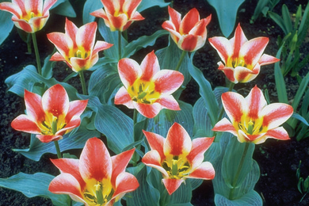
Multivariate Polynomial Mapping Function
Parametric color-to-grayscale

Slide 39
Multivariate Polynomial Mapping Function
Parametric color-to-grayscale

Slide 40
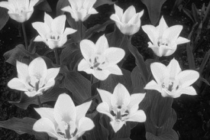
Multivariate Polynomial Mapping Function
Parametric color-to-grayscale

Slide 41
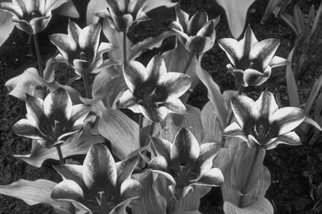
Multivariate Polynomial Mapping Function
Parametric color-to-grayscale

Slide 42
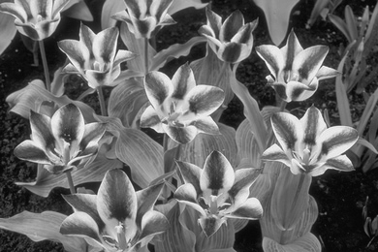
Multivariate Polynomial Mapping Function
Parametric color-to-grayscale

Slide 43
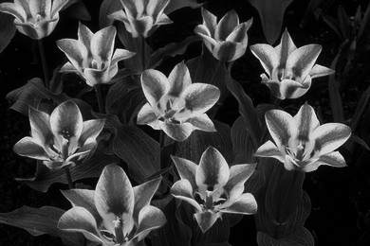
Multivariate Polynomial Mapping Function
Parametric color-to-grayscale

Slide 44
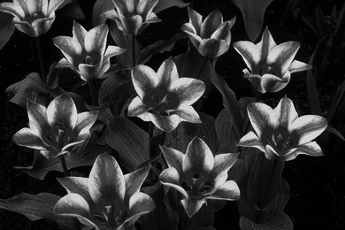
Multivariate Polynomial Mapping Function
Parametric color-to-grayscale

Slide 45
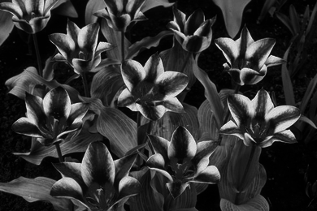
Multivariate Polynomial Mapping Function
Parametric color-to-grayscale

Slide 46
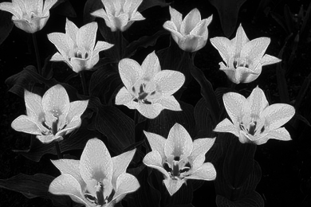
Multivariate Polynomial Mapping Function
Parametric color-to-grayscale

Slide 47
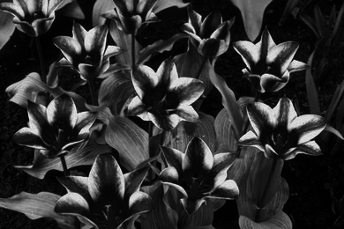
Multivariate Polynomial Mapping Function
Parametric color-to-grayscale

Slide 48
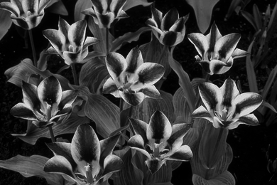
Multivariate Polynomial Mapping Function
Parametric color-to-grayscale

Slide 49
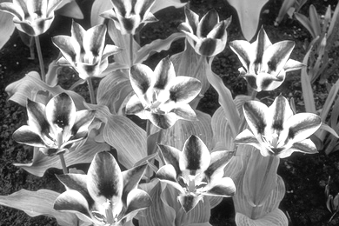
Multivariate Polynomial Mapping Function
Parametric color-to-grayscale
0.1550
0.8835
0.3693
0.1817
0.4977
-1.7275
-0.4479
0.6417
0.6234

Slide 50
Multivariate Polynomial Mapping Function
Parametric color-to-grayscale
0.1550
0.8835
0.3693
0.1817
0.4977
-1.7275
-0.4479
0.6417
0.6234

Slide 51
Our Model
Objective function:

Slide 52
Numerical Solution
Define:

Slide 53
Numerical Solution
Notes:
linear

Slide 54
Numerical Solution
Initialize :

Slide 55
Numerical Solution
obtain

Slide 56
Numerical Solution
obtain
obtain

Slide 57
Numerical Solution
obtain
obtain

Slide 58
Numerical Solution
obtain
obtain

Slide 59
Numerical Solution
obtain
obtain

Slide 60
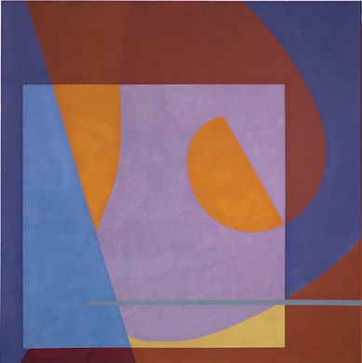
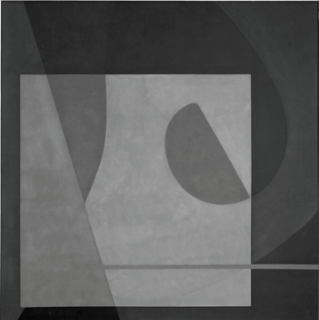
Numerical Solution (Example)
Iter 1
0.33 0.33 0.33 0.00 0.00 0.00 0.00 0.00 0.00

Slide 61
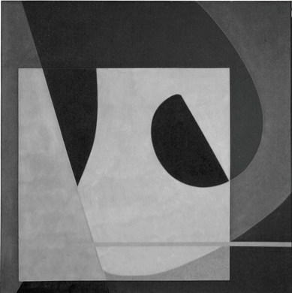
Numerical Solution (Example)
Iter 2
0.97 0.91 0.38 -3.71 2.46 -4.01 -4.02 4.00 0.79

Slide 62
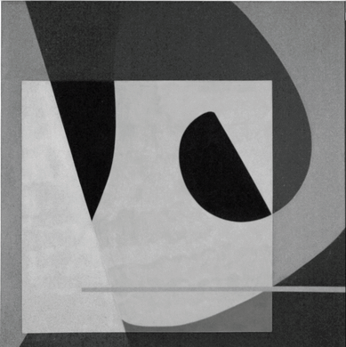
Numerical Solution (Example)
Iter 3
1.14 -0.25 1.22 -1.55 -1.53 -3.51 -1.18 3.32 0.69

Slide 63
Numerical Solution (Example)
Iter 4
1.33 -1.61 2.10 1.35 -0.36 -1.61 -1.69 1.70 0.29

Slide 64
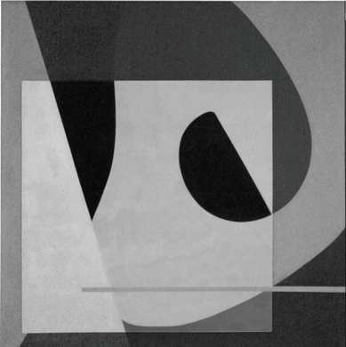
Numerical Solution (Example)
Iter 5
1.52 -2.25 2.46 2.69 -1.38 -0.30 -1.95 0.79 -0.02

Slide 65

Numerical Solution (Example)
Iter 13
1.98 -3.29 3.02 5.94 -3.38 2.81 -2.91 -1.56 -0.96

Slide 66

Numerical Solution (Example)
Iter 14
1.99 -3.31 3.03 6.03 -3.42 2.89 -2.95 -1.62 -0.98

Slide 67

Numerical Solution (Example)
Iter 15
2.00 -3.32 3.04 6.10 -3.45 2.94 -2.98 -1.67 -1.00

Slide 68



Results
Input
Ours
[Rasche et al. 2005]
[Kim et al. 2009]

Slide 69




Results
Input
Ours
[Rasche et al. 2005]
[Kim et al. 2009]

Slide 70


Results
Input
Ours
[Rasche et al. 2005]
[Kim et al. 2009]

Slide 71




Results
Input
Ours
[Rasche et al. 2005]
[Kim et al. 2009]

Slide 72
Results (Quantitative Evaluation)
color contrast preserving ratio (CCPR)
the set containing all neighboring pixel pairs with the original color difference .

Slide 73


Results (Quantitative Evaluation)

Slide 74

Our Results (Quantitative Evaluation)

Slide 75

Results (Quantitative Evaluation)
Notes:
Red region: color contrast > 10. Green region: gray contrast > 10 under color contrast > 10.

Slide 76
Results (Quantitative Evaluation)
Number: 38740
Number: 24853
Notes:
Red region: color contrast > 10. Green region: gray contrast > 10 under color contrast > 10.

Slide 77
Results (Quantitative Evaluation)
Number: 38740
Number: 24853
Notes:
Red region: color contrast > 10. Green region: gray contrast > 10 under color contrast > 10.

Slide 78
Results (Quantitative Evaluation)

Slide 79




Results (contrast boosting)
substituting our grayscale image for the L channel in the Lab space

Slide 80




Results (contrast boosting)
substituting our grayscale image for the L channel in the Lab space

Slide 81
Conclusion
A new color-to-grayscale method that can well maintain the color contrast.
Weak color constraint.
Polynomial Mapping Function for global mapping.

Slide 82
The End

Slide 83
Limitations
Color2gray is very subjective visual experience. Contrast enhancement may not be acceptable for everyone.
Compared to the naive color2grayscale mapping, our method is less efficient due to the extra operations.

Slide 84


An arguable result
Notes:
Contrast is maintain, but it is unpleasing.

Slide 85
Running Time
For a 600 × 600 color input, our Matlab implementation takes 0.8s
A C-language implementation can be 10 times faster at least.

